Slide 1
Ethereum Emulation Lab

Slide 2
Why Emulation？
To feel how it works
To know how exactly it works
Without disturbing the block chain in production
Without waiting too long

Slide 3
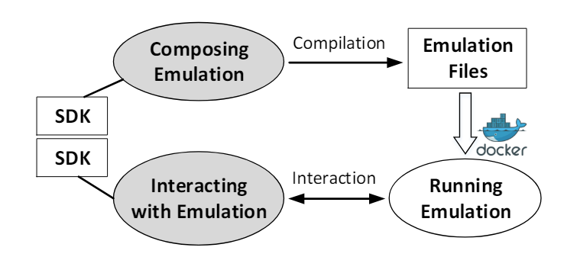
The Ethereum Emulator
Ethereum Emulator
Internet Emulator

Slide 4
PoW vs PoS
Bitcoin
Proof of Work
A randomly chosen miner gets the right to propose a new block
The probability is related to the computing capability devoted.
ETH
Proof of Stake
Nodes pledge their coins to join the chain
A randomly chosen node gets the right to propose a new block (validator)
The propobility is related to the coins pledged.
The validator gets interests if honestly varified the transactions or gets slashing

Slide 5
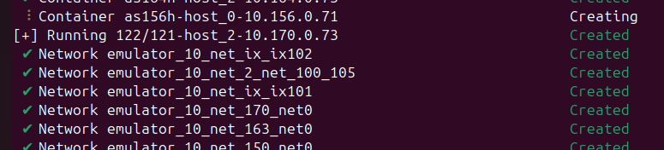
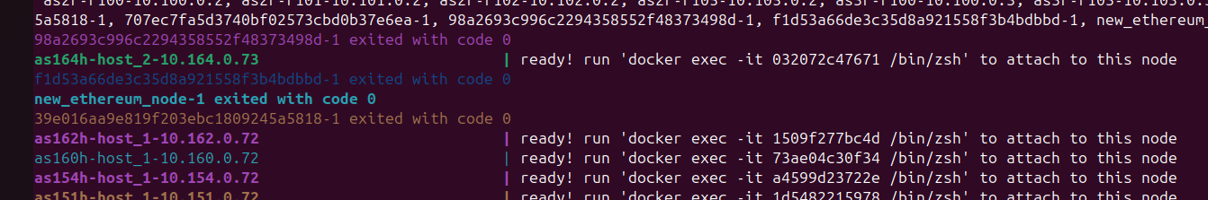
Docker Preparation
Even the plan with least nodes, i.e., emulator_10
It has 121 containers
You see emulation nodes ready info when it is done.

Slide 6
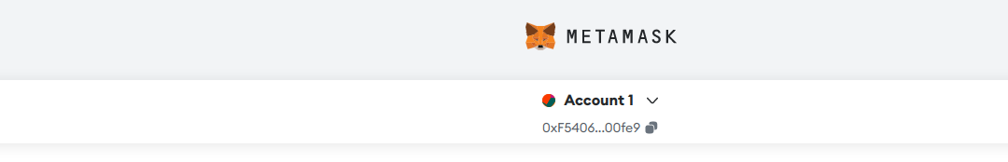
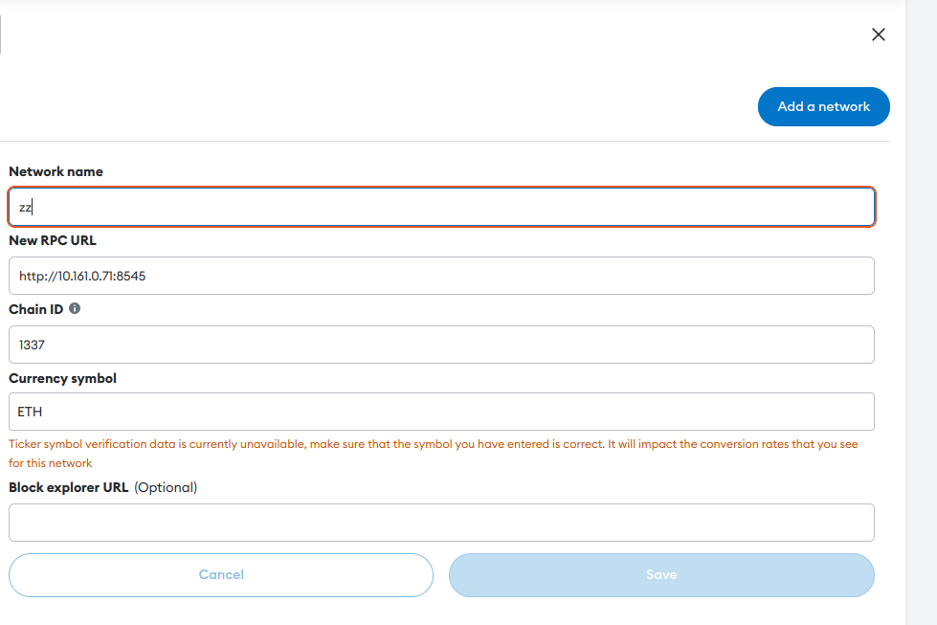
Task 1.a&b: Setting Up MetaMask Wallet
Step 1: Install add-ons
Step 2: Connect to the emulated Ethereum

Slide 7
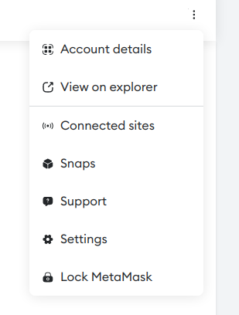
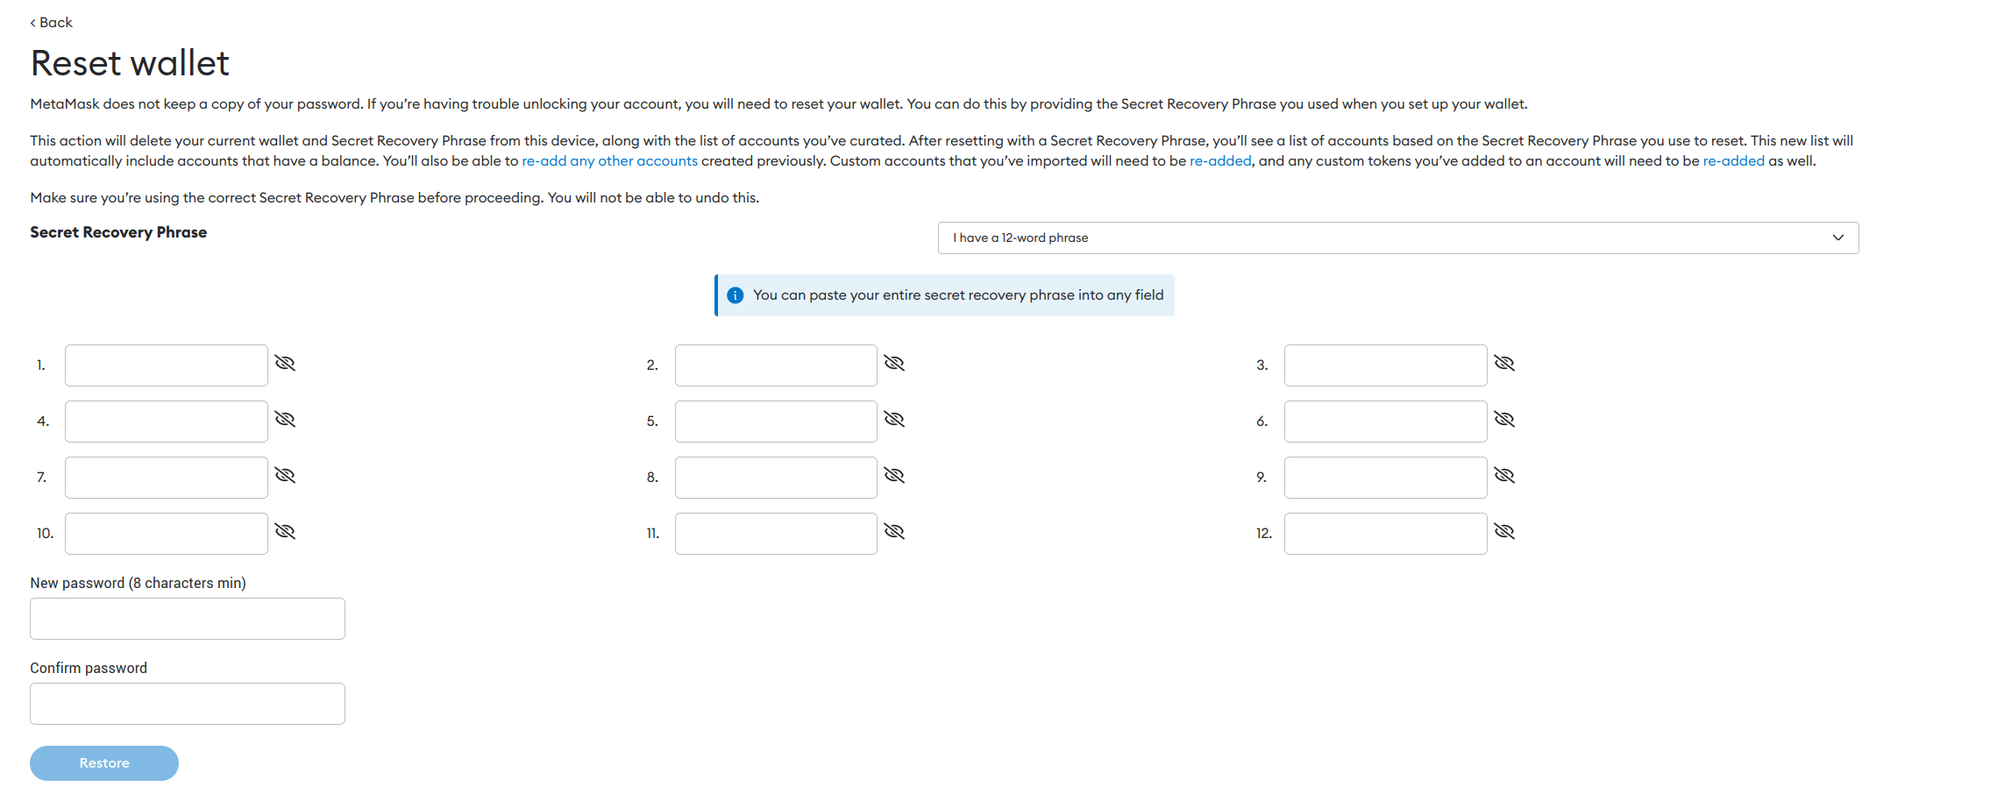
Task 1.c: Recovering Accounts
Firstly Lock your account
Then press “forgot password”
Why do we need strange phrases?

Slide 8
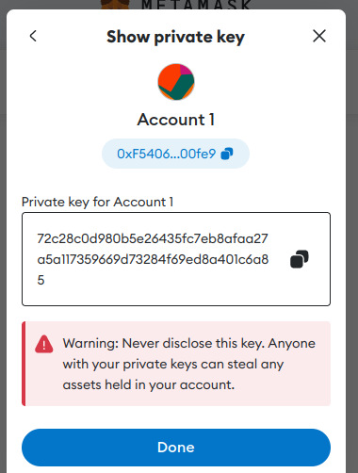
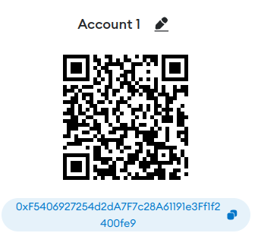
Task 1.c: Recovering Accounts
What an account has?
It has an address, or public key
And a private key

Slide 9

Task 1.d: Send some coins to others
Operate on the UI
Then check the chain log on localhost:5000

Slide 10
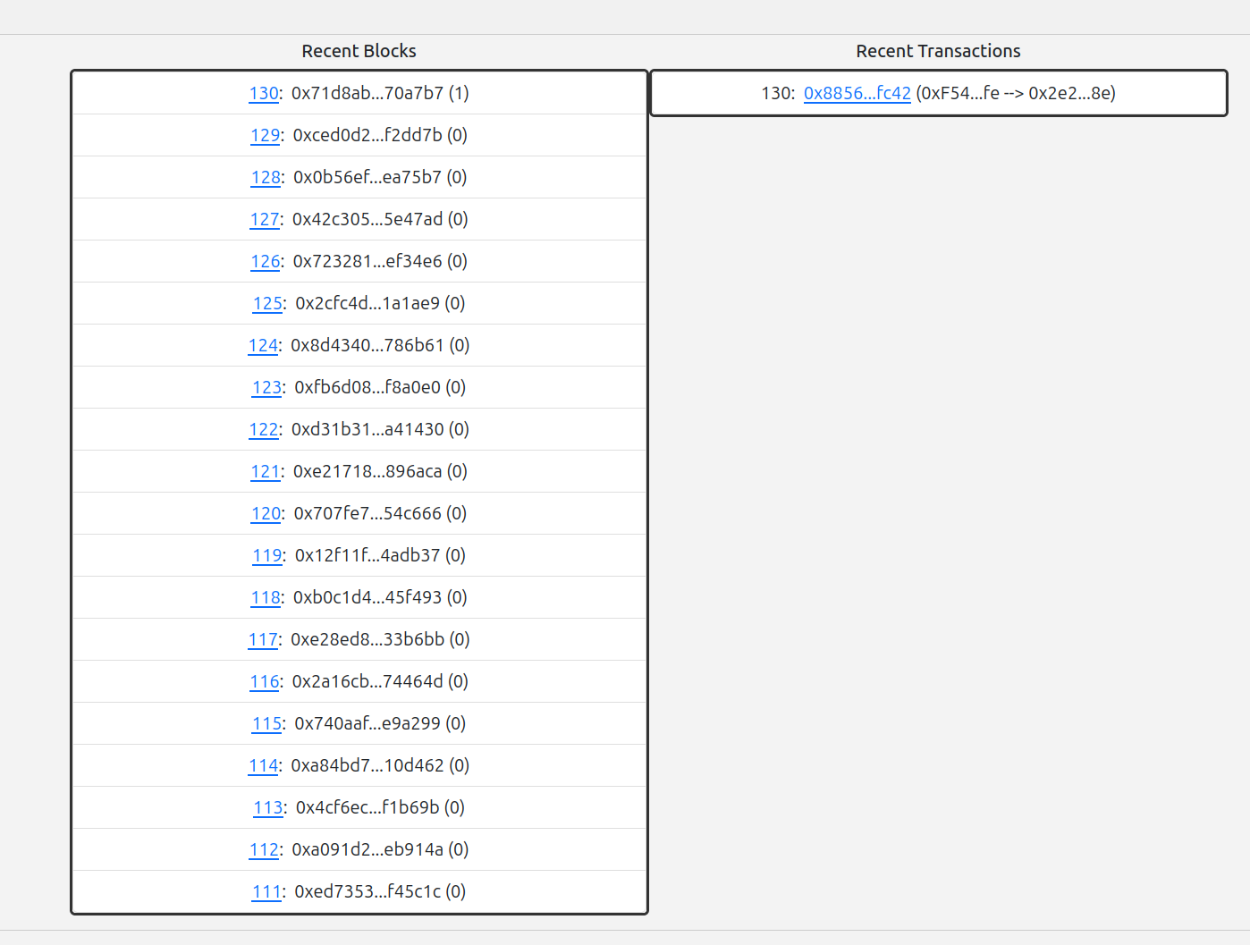
Transaction Log on the Chain

Slide 11
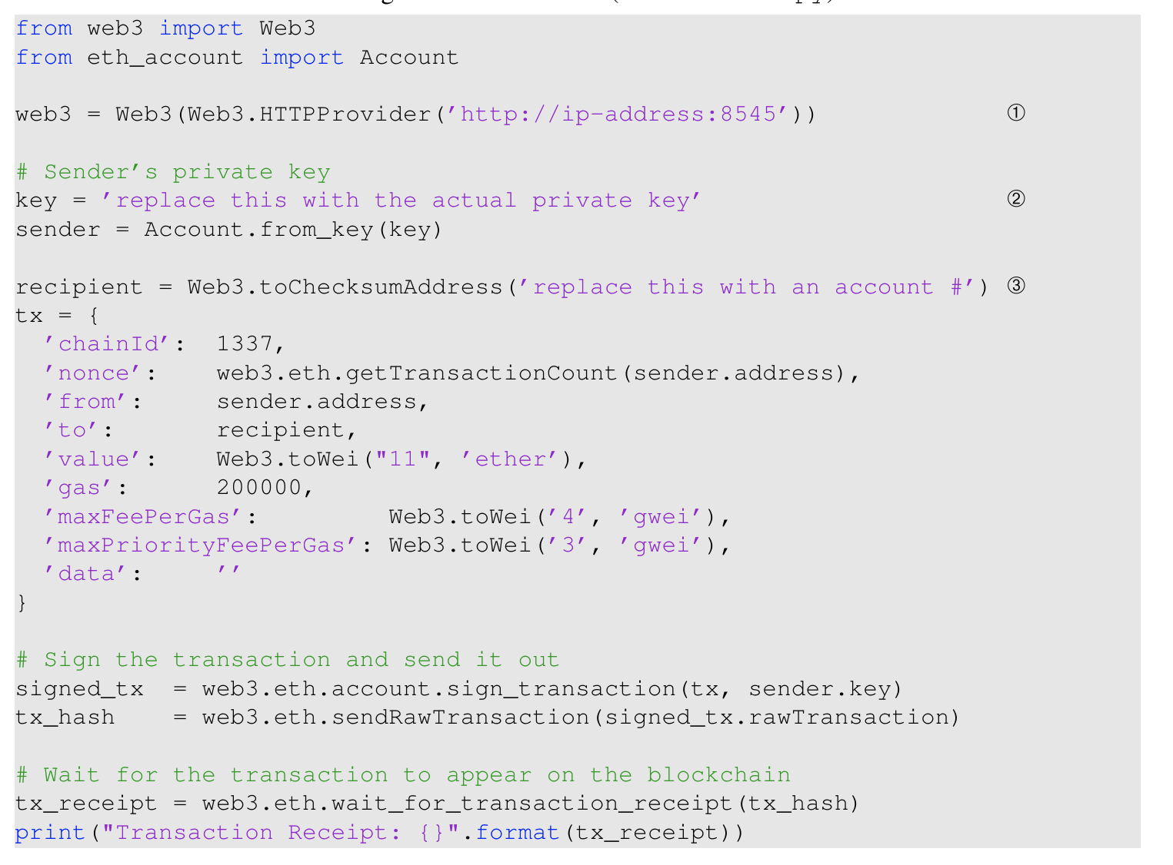
Task2: Interacting with Ether Using Python

Slide 12
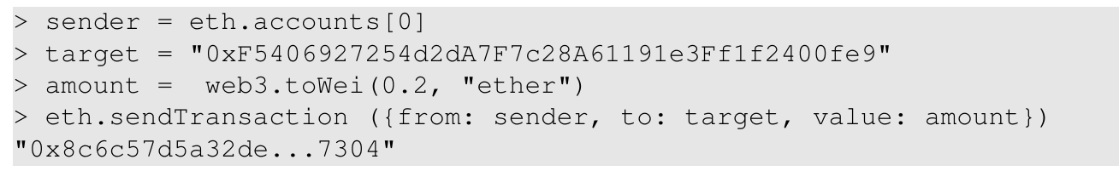
Task 3: Logging into a Geth node
JSON-RPC
MetaMask
Geth
Shell/SSH
Console

Slide 13
Task4: Adding a Geth Node
An empty container called new eth node
You need to start Geth on it.
Firstly get the latest chain
Use start.sh to start Geth
Check the peers to the node

